Slide 1

#LETSTALKABOUTIT
Team 16

Slide 2

Video Slide.

Slide 3

Let’s Talk About Alzheimer’s
Did the video affect you?
Could you finish your education?
That holiday you’ve been planning, can you now go?
That part-time job, will it be full-time now?
Alzheimer’s can affect you on a personal level, in very profound ways. It’s easy enough to ignore until it has happened, but in order to stand a chance at making a difference we need to start the discussion long before then.
Notes:
How many peop

Slide 4
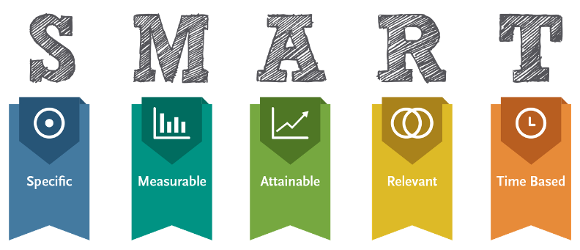
Goals
Personal
Shareable
Simplicity
Awareness
Relatable

Slide 5

Why did we pick this approach
It is simple, relatable, and hits home.
Imagine all the hobbies, social activities and parties you have to miss to look after your loved one who is affected by Alzheimer's.
It can happen to anyone, and it can be prevented with your help and support.
The best prevention is talking about it and becoming aware of all the issues by looking for the signs - sharing, donating and raising awareness helps forward research.

Slide 6
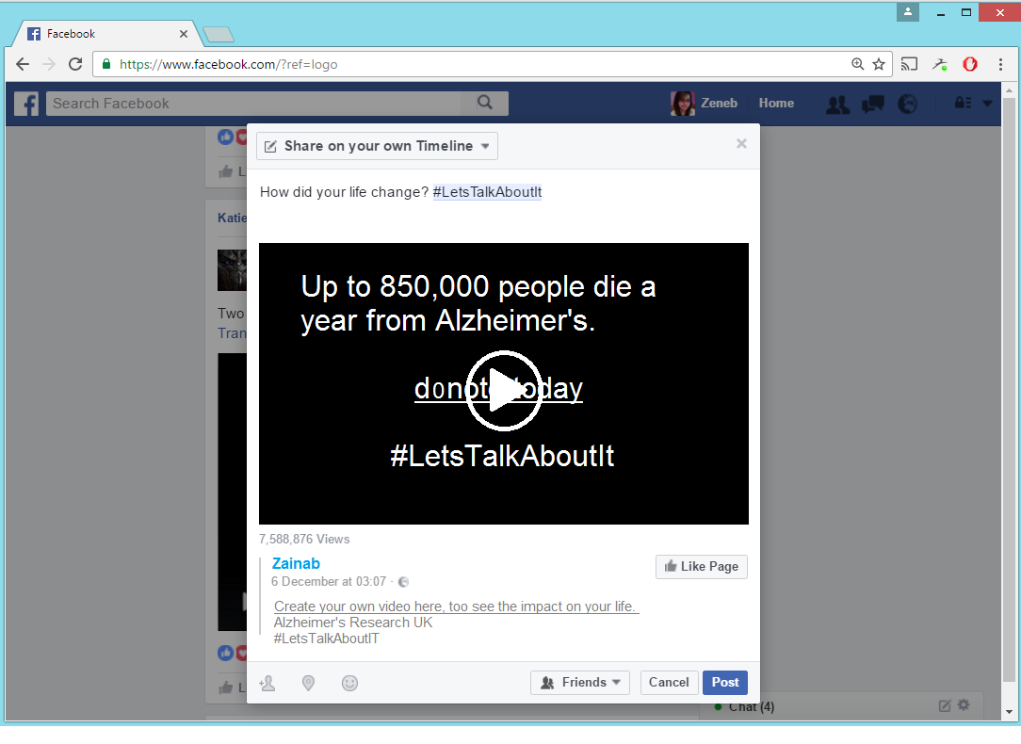
Share It!
There are 850,000 people with dementia in the UK.

Slide 7




How it works
The user clicks ‘create video’ which will ask for their permission to collect personalised information about the user. Facebook APIs will allow the application to decide which information should be used and then picks the images to be used for the video.
The tool will use hobbies, likes and social activities to create dynamic captions and images that make the video more relatable to the user.
The #LetsTalkAboutIt hashtag will begin a discussion and start a trending hashtag on social media, where more and more users will create their videos and share it on their timeline.
We hope that the video will be shared across Facebook, Twitter, Instagram and other social media platforms. We also envision users might even set up Reddit threads to talk about Alzheimer’s.

Slide 8
Further Implementation
Since our time is limited, we suggested the following ideas that could be included:
More meaningful data using better algorithms to find the best personalised images and captions, which can be more relatable than the generic ones that we’ve created.
Better video quality, since we are Computer Science students and we lack the required level of creative media design.
Better safeguards against un-optimised Facebook profiles, meaning users who do not fill out their profiles.

Slide 9

Bye

